Slide 1

DIVINE GRACE COLLEGE OF ARTS, SCIENCE AND TECHNOLOGY
(DGCAST) — GAROUA | GEOGRAPHY DEPARTMENT
UPPER SIXTH ARTS — PRACTICAL GEOGRAPHY — MAP ANALYSIS 4
Drainage on Maps
Mr KAMDEM EMMANUEL
Geography Teacher — PLEG
Academic Year 2026 / 2027
Notes:
Good morning, class. Today we study Map Analysis 4: Drainage on Maps.

Slide 2
GEOGRAPHY — UPPER SIXTH ARTS
CLASS INFO
Class, Chapter & Duration
Class | Upper Sixth Arts
Chapter | Module 8: Understanding and carrying out statistical techniques, topographic map analysis, fieldwork and project based learning
Duration | 2 periods (2 × 50 minutes)
2026 / 2027
DGCAST GAROUA — GEOGRAPHY DEPARTMENT
Mr KAMDEM E. | 2

Slide 3
GEOGRAPHY — UPPER SIXTH ARTS
IDENTIFICATION
Lesson Identification
Topic | Topographic Map Analysis
Sub-topic | Hydrological Analysis
Lesson | Map Analysis 4: Drainage on Maps
Notions / Concepts | Stream order, Strahler, bifurcation ratio, drainage density, stream frequency, sinuosity, drainage pattern.
Syllabus focus | Stream ordering (Strahler) and bifurcation ratio; drainage density and stream frequency; sinuosity; stream patterns; description of drainage.
Competence | Learners are able to order streams, calculate drainage indices and identify drainage patterns on a map.
2026 / 2027
DGCAST GAROUA — GEOGRAPHY DEPARTMENT
Mr KAMDEM E. | 3

Slide 4
GEOGRAPHY — UPPER SIXTH ARTS
OBJECTIVES
Learning Objectives
By the end of the lesson, the learner should be able to:
Order streams using Strahler's method.
Calculate the bifurcation ratio, drainage density and sinuosity.
Identify and explain drainage patterns.
2026 / 2027
DGCAST GAROUA — GEOGRAPHY DEPARTMENT
Mr KAMDEM E. | 4

Slide 5
GEOGRAPHY — UPPER SIXTH ARTS
RECALL
Recall
Small streams join to form rivers.
A drainage basin is the area drained by a river.
2026 / 2027
DGCAST GAROUA — GEOGRAPHY DEPARTMENT
Mr KAMDEM E. | 5

Slide 6
GEOGRAPHY — UPPER SIXTH ARTS
REAL-LIFE SITUATION
Real-Life Situation
The Benue basin floods often. An engineer asks the class to study a map of a small basin, order its streams and calculate indices to judge the flood risk.
2026 / 2027
DGCAST GAROUA — GEOGRAPHY DEPARTMENT
Mr KAMDEM E. | 6
Notes:
Read the situation slowly, twice.

Slide 7
GEOGRAPHY — UPPER SIXTH ARTS
REAL-LIFE SITUATION
Situation — Question 1
What is the problem in the situation?
2026 / 2027
DGCAST GAROUA — GEOGRAPHY DEPARTMENT
Mr KAMDEM E. | 7

Slide 8
GEOGRAPHY — UPPER SIXTH ARTS
REAL-LIFE SITUATION
Answer
The class must assess flood risk from the drainage.
2026 / 2027
DGCAST GAROUA — GEOGRAPHY DEPARTMENT
Mr KAMDEM E. | 8

Slide 9
GEOGRAPHY — UPPER SIXTH ARTS
REAL-LIFE SITUATION
Situation — Question 2
Which method orders streams?
2026 / 2027
DGCAST GAROUA — GEOGRAPHY DEPARTMENT
Mr KAMDEM E. | 9

Slide 10
GEOGRAPHY — UPPER SIXTH ARTS
REAL-LIFE SITUATION
Answer
Strahler's method.
2026 / 2027
DGCAST GAROUA — GEOGRAPHY DEPARTMENT
Mr KAMDEM E. | 10

Slide 11
GEOGRAPHY — UPPER SIXTH ARTS
REAL-LIFE SITUATION
Situation — Question 3
Which index is linked to flood risk?
2026 / 2027
DGCAST GAROUA — GEOGRAPHY DEPARTMENT
Mr KAMDEM E. | 11

Slide 12
GEOGRAPHY — UPPER SIXTH ARTS
REAL-LIFE SITUATION
Possible Answer
The bifurcation ratio (also drainage density).
2026 / 2027
DGCAST GAROUA — GEOGRAPHY DEPARTMENT
Mr KAMDEM E. | 12

Slide 13
GEOGRAPHY — UPPER SIXTH ARTS
JUSTIFICATION
Justification of the Lesson
This lesson helps us to analyse rivers and flood risk from maps.
2026 / 2027
DGCAST GAROUA — GEOGRAPHY DEPARTMENT
Mr KAMDEM E. | 13

Slide 14
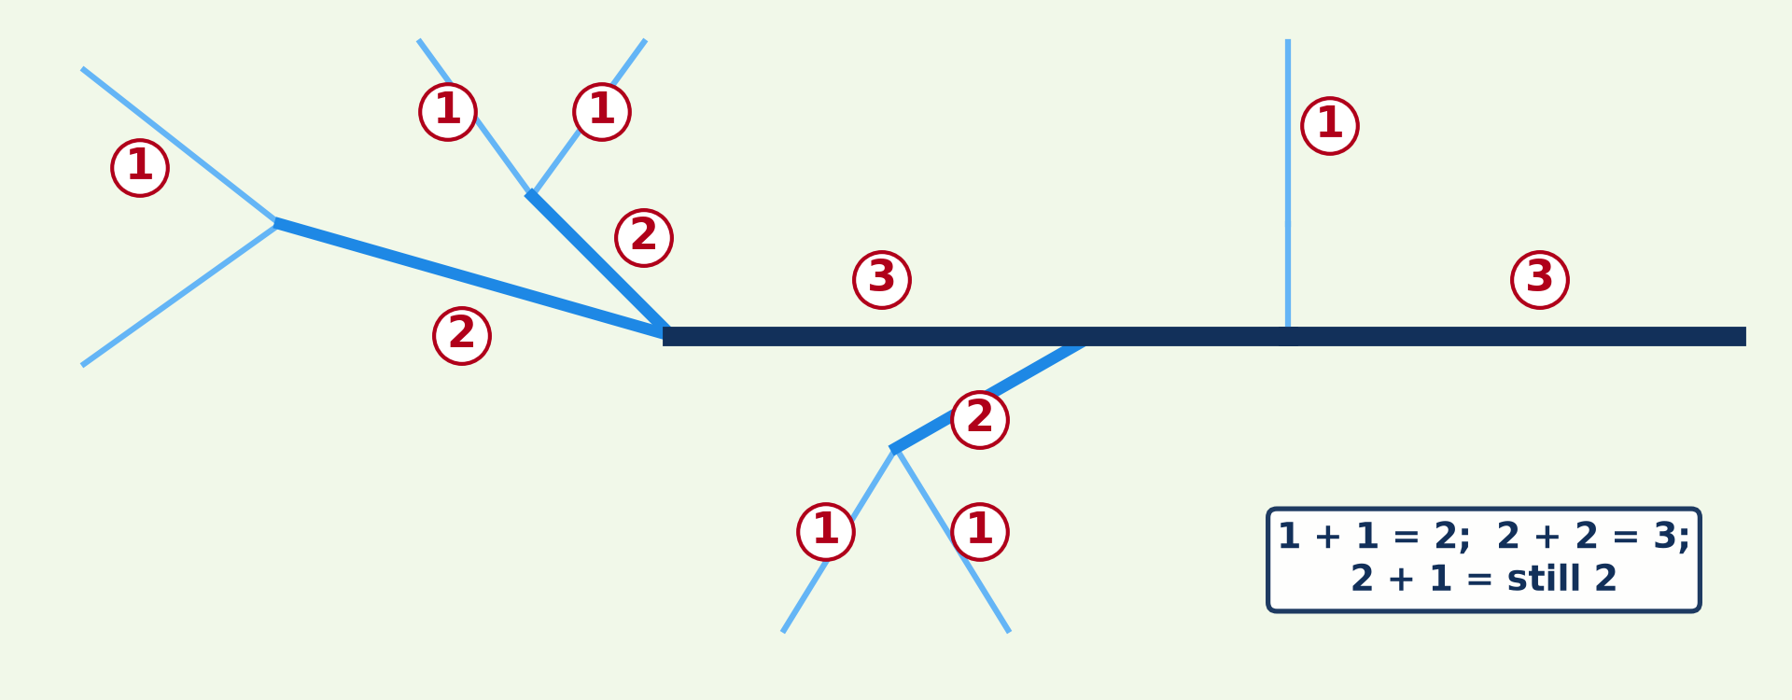
GEOGRAPHY — UPPER SIXTH ARTS
I. STREAM ORDER
Activity 1
Strahler stream ordering.
2026 / 2027
DGCAST GAROUA — GEOGRAPHY DEPARTMENT
Mr KAMDEM E. | 14
Notes:
Without the projector: order a network.

Slide 15
GEOGRAPHY — UPPER SIXTH ARTS
I. STREAM ORDER
Activity 1: Question
What happens when two 2nd-order streams meet? And a 2nd and a 1st?
2026 / 2027
DGCAST GAROUA — GEOGRAPHY DEPARTMENT
Mr KAMDEM E. | 15

Slide 16
GEOGRAPHY — UPPER SIXTH ARTS
I. STREAM ORDER
Answer
They form a 3rd-order stream; 2 + 1 stays 2nd order.
2026 / 2027
DGCAST GAROUA — GEOGRAPHY DEPARTMENT
Mr KAMDEM E. | 16

Slide 17
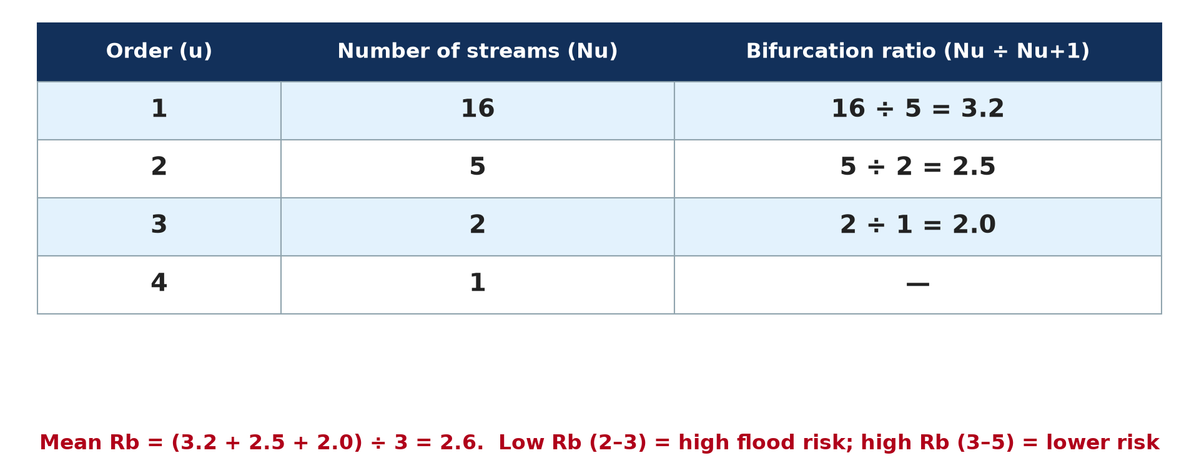
GEOGRAPHY — UPPER SIXTH ARTS
I. BIFURCATION RATIO
Activity 2
Bifurcation ratios.
2026 / 2027
DGCAST GAROUA — GEOGRAPHY DEPARTMENT
Mr KAMDEM E. | 17
Notes:
Without the projector: calculate each ratio.

Slide 18
GEOGRAPHY — UPPER SIXTH ARTS
I. BIFURCATION RATIO
Activity 2: Question
Calculate Rb between orders 1 and 2 if there are 16 and 5 streams.
2026 / 2027
DGCAST GAROUA — GEOGRAPHY DEPARTMENT
Mr KAMDEM E. | 18

Slide 19
GEOGRAPHY — UPPER SIXTH ARTS
I. BIFURCATION RATIO
Answer
16 ÷ 5 = 3.2.
2026 / 2027
DGCAST GAROUA — GEOGRAPHY DEPARTMENT
Mr KAMDEM E. | 19

Slide 20
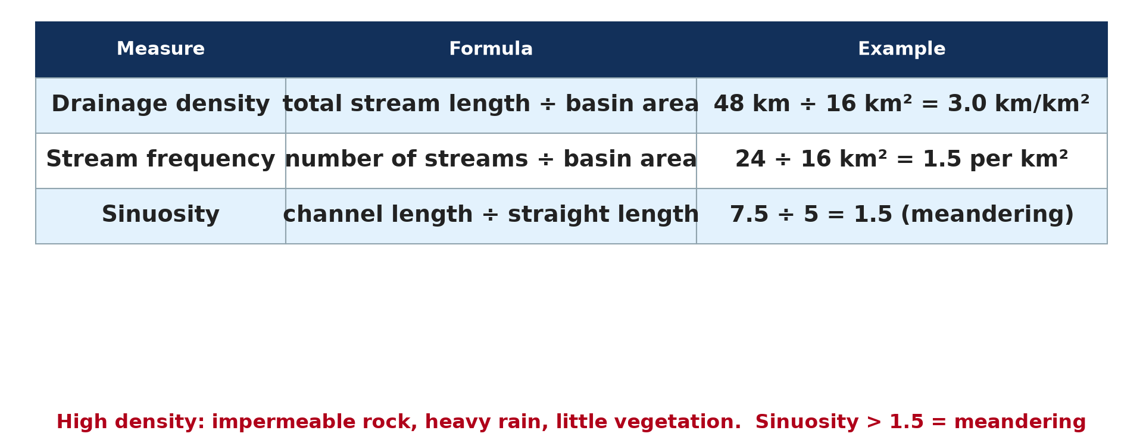
GEOGRAPHY — UPPER SIXTH ARTS
II. DENSITY AND SINUOSITY
Activity 3
Drainage calculations.
2026 / 2027
DGCAST GAROUA — GEOGRAPHY DEPARTMENT
Mr KAMDEM E. | 20
Notes:
Without the projector: calculate density.

Slide 21
GEOGRAPHY — UPPER SIXTH ARTS
II. DENSITY AND SINUOSITY
Activity 3: Question
A basin of 20 km² has 50 km of streams. Find the drainage density.
2026 / 2027
DGCAST GAROUA — GEOGRAPHY DEPARTMENT
Mr KAMDEM E. | 21

Slide 22
GEOGRAPHY — UPPER SIXTH ARTS
II. DENSITY AND SINUOSITY
Answer
50 ÷ 20 = 2.5 km per km².
2026 / 2027
DGCAST GAROUA — GEOGRAPHY DEPARTMENT
Mr KAMDEM E. | 22

Slide 23
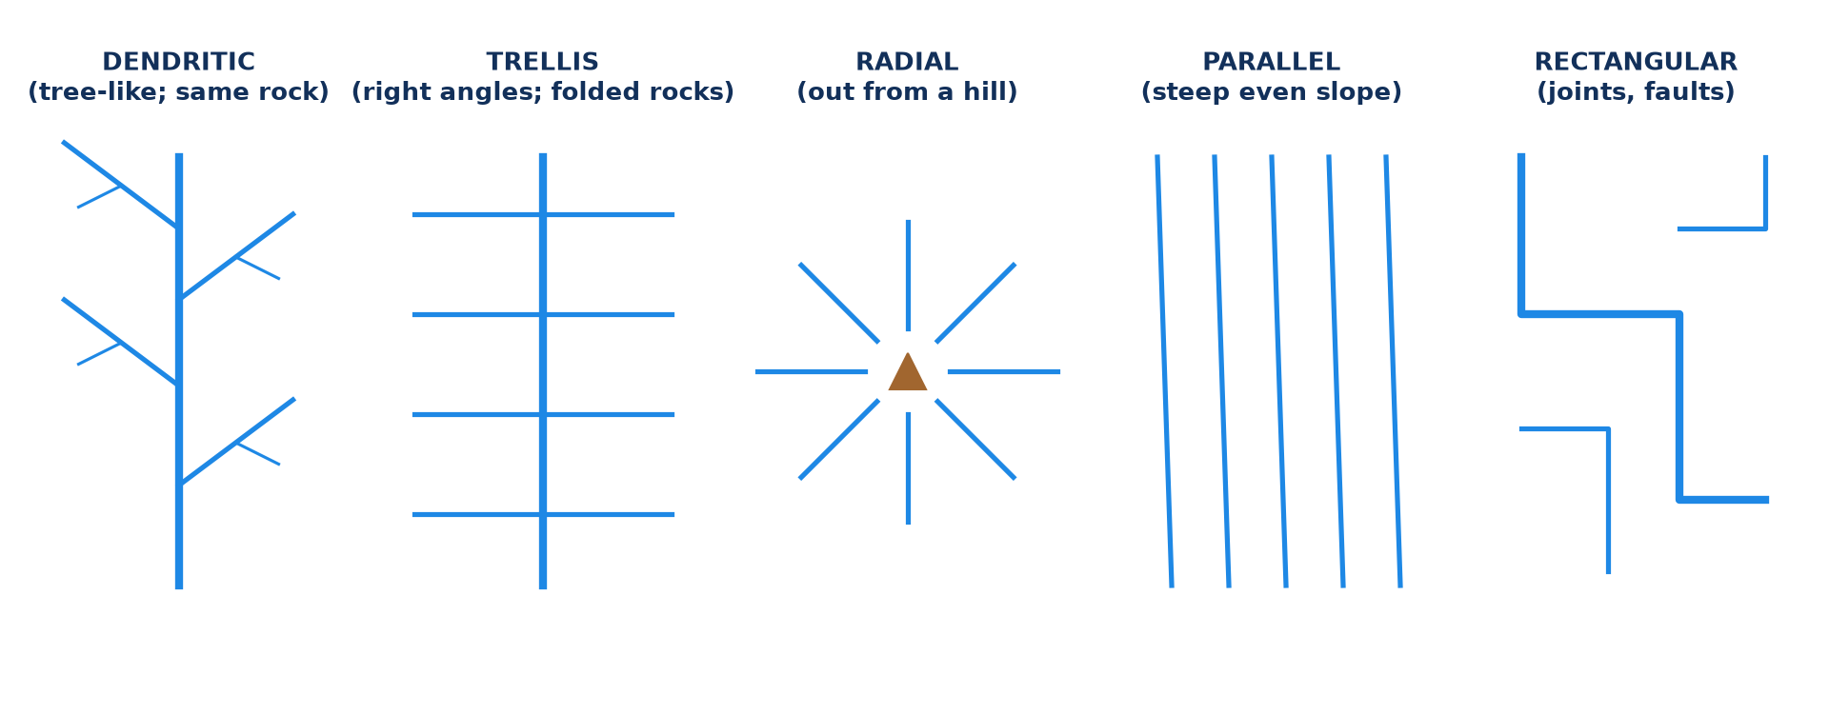
GEOGRAPHY — UPPER SIXTH ARTS
III. PATTERNS
Activity 4
Drainage patterns.
2026 / 2027
DGCAST GAROUA — GEOGRAPHY DEPARTMENT
Mr KAMDEM E. | 23
Notes:
Without the projector: draw the patterns.

Slide 24
GEOGRAPHY — UPPER SIXTH ARTS
III. PATTERNS
Activity 4: Question
Which pattern develops on uniform rock, and which around a volcano?
2026 / 2027
DGCAST GAROUA — GEOGRAPHY DEPARTMENT
Mr KAMDEM E. | 24

Slide 25
GEOGRAPHY — UPPER SIXTH ARTS
III. PATTERNS
Answer
Dendritic on uniform rock; radial around a volcano.
2026 / 2027
DGCAST GAROUA — GEOGRAPHY DEPARTMENT
Mr KAMDEM E. | 25

Slide 26

GEOGRAPHY — UPPER SIXTH ARTS
IV. DESCRIPTION
Activity 5
A map extract (invented).
2026 / 2027
DGCAST GAROUA — GEOGRAPHY DEPARTMENT
Mr KAMDEM E. | 26
Notes:
Without the projector: describe the drainage.

Slide 27
GEOGRAPHY — UPPER SIXTH ARTS
IV. DESCRIPTION
Activity 5: Question
In which direction does the main river flow? Give evidence.
2026 / 2027
DGCAST GAROUA — GEOGRAPHY DEPARTMENT
Mr KAMDEM E. | 27

Slide 28
GEOGRAPHY — UPPER SIXTH ARTS
IV. DESCRIPTION
Answer
It flows south from the northern edge, then east, from higher to lower contours.
2026 / 2027
DGCAST GAROUA — GEOGRAPHY DEPARTMENT
Mr KAMDEM E. | 28

Slide 29
GEOGRAPHY — UPPER SIXTH ARTS
BOARD SUMMARY
Drainage on Maps
Topic: Topographic Map Analysis
Sub-topic: Hydrological Analysis
Map Analysis 4: Drainage on Maps
2026 / 2027
DGCAST GAROUA — GEOGRAPHY DEPARTMENT
Mr KAMDEM E. | 29
Notes:
Learners copy the board summary now. Give them enough time for each slide.

Slide 30
GEOGRAPHY — UPPER SIXTH ARTS
BOARD SUMMARY
I. Definitions
Stream order: It is the rank of a stream in a network, from 1 for the smallest streams.
Bifurcation ratio: It is the number of streams of one order divided by the number of the next order.
Drainage density: It is the total length of streams divided by the area of the basin.
2026 / 2027
DGCAST GAROUA — GEOGRAPHY DEPARTMENT
Mr KAMDEM E. | 30

Slide 31
GEOGRAPHY — UPPER SIXTH ARTS
BOARD SUMMARY
II. Calculations (1/3)
A. Strahler ordering: Two streams of the same order make the next order. A lower order joining does not change the order.
B. Bifurcation ratio: Rb = Nu ÷ Nu+1; the mean Rb is usually 3 to 5. A low Rb means a round basin and a higher flood risk.
2026 / 2027
DGCAST GAROUA — GEOGRAPHY DEPARTMENT
Mr KAMDEM E. | 31

Slide 32
GEOGRAPHY — UPPER SIXTH ARTS
BOARD SUMMARY
II. Calculations (2/3)
C. Other indices: Stream frequency is the number of streams per km². Sinuosity is channel length divided by straight length; above 1.5 means meandering.
2026 / 2027
DGCAST GAROUA — GEOGRAPHY DEPARTMENT
Mr KAMDEM E. | 32

Slide 33
GEOGRAPHY — UPPER SIXTH ARTS
BOARD SUMMARY
II. Calculations (3/3)
Copy the ordering.
2026 / 2027
DGCAST GAROUA — GEOGRAPHY DEPARTMENT
Mr KAMDEM E. | 33

Slide 34
GEOGRAPHY — UPPER SIXTH ARTS
BOARD SUMMARY
III. Patterns and Description
A. Patterns: Dendritic, trellis, radial, parallel and rectangular patterns reflect rock and slope. Structure controls the pattern.
B. Description: State the main river, its direction, tributaries and pattern. Relate the drainage to relief with map evidence.
2026 / 2027
DGCAST GAROUA — GEOGRAPHY DEPARTMENT
Mr KAMDEM E. | 34

Slide 35
GEOGRAPHY — UPPER SIXTH ARTS
FORMATIVE EVALUATION
Formative Evaluation 1
A basin has 12 first-order and 3 second-order streams. Find Rb.
2026 / 2027
DGCAST GAROUA — GEOGRAPHY DEPARTMENT
Mr KAMDEM E. | 35

Slide 36
GEOGRAPHY — UPPER SIXTH ARTS
FORMATIVE EVALUATION
Expected Answer
12 ÷ 3 = 4.0.
2026 / 2027
DGCAST GAROUA — GEOGRAPHY DEPARTMENT
Mr KAMDEM E. | 36

Slide 37
GEOGRAPHY — UPPER SIXTH ARTS
FORMATIVE EVALUATION
Formative Evaluation 2
A river is 9 km long; the straight line is 6 km. Find sinuosity.
2026 / 2027
DGCAST GAROUA — GEOGRAPHY DEPARTMENT
Mr KAMDEM E. | 37

Slide 38
GEOGRAPHY — UPPER SIXTH ARTS
FORMATIVE EVALUATION
Expected Answer
9 ÷ 6 = 1.5 (meandering).
2026 / 2027
DGCAST GAROUA — GEOGRAPHY DEPARTMENT
Mr KAMDEM E. | 38

Slide 39
GEOGRAPHY — UPPER SIXTH ARTS
REMEDIATION
Remediation
Fill in the blanks:
Stream ordering method: ______.
Length of streams ÷ basin area = drainage ______.
A tree-like pattern is ______.
2026 / 2027
DGCAST GAROUA — GEOGRAPHY DEPARTMENT
Mr KAMDEM E. | 39
Notes:
Answers: 1. Strahler 2. density 3. dendritic

Slide 40
GEOGRAPHY — UPPER SIXTH ARTS
HOMEWORK
Homework
Trace a river network from a map, order its streams and calculate the mean bifurcation ratio.
This prepares Map Analysis 5: Vegetation on Maps.
2026 / 2027
DGCAST GAROUA — GEOGRAPHY DEPARTMENT
Mr KAMDEM E. | 40
Notes:
This homework prepares the next lesson.

Slide 41
GEOGRAPHY — UPPER SIXTH ARTS
BILINGUAL GAME
Bilingual Game (Jeu Bilingue)
English | Français
Stream | Le cours d'eau
Tributary | L'affluent
Drainage basin | Le bassin versant
Pattern | Le réseau
Density | La densité
Meander | Le méandre
2026 / 2027
DGCAST GAROUA — GEOGRAPHY DEPARTMENT
Mr KAMDEM E. | 41
Notes:
Say the English word; learners give the French word, then the reverse.

Slide 42
GEOGRAPHY — UPPER SIXTH ARTS
LOGBOOK
Official Logbook (1/2)
Module / Topic | Topographic Map Analysis
Lesson Title | Map Analysis 4: Drainage on Maps
Expected Learning Outcomes | Order streams using Strahler's method. Calculate the bifurcation ratio, drainage density and sinuosity. Identify and explain drainage patterns.
Competence | Learners are able to order streams, calculate drainage indices and identify drainage patterns on a map.
2026 / 2027
DGCAST GAROUA — GEOGRAPHY DEPARTMENT
Mr KAMDEM E. | 42

Slide 43
GEOGRAPHY — UPPER SIXTH ARTS
LOGBOOK
Official Logbook (2/2)
Matter Taught | I. Definitions: Stream order, Bifurcation ratio, Drainage density; II. Calculations: Strahler ordering, Bifurcation ratio, Other indices; III. Patterns and Description: Patterns, Description.
Evaluation | Formative evaluation (3 questions) and remediation exercise.
Homework | Trace a river network from a map, order its streams and calculate the mean bifurcation ratio.
Enrolment / Present / Absent | ____ / ____ / ____
Achievement | To be completed by the teacher after the lesson.
2026 / 2027
DGCAST GAROUA — GEOGRAPHY DEPARTMENT
Mr KAMDEM E. | 43

Slide 44
GEOGRAPHY — UPPER SIXTH ARTS
TEACHER'S NOTE
Teacher's Note
Timing: Set-up, recall 8 min | Situation 8 min | 5 activities 30 min | Board summary (copying) 30 min | Evaluation, remediation 10 min | Homework, logbook 9 min | Spare 5 min
2026 / 2027
DGCAST GAROUA — GEOGRAPHY DEPARTMENT
Mr KAMDEM E. | 44

Slide 45
GEOGRAPHY — UPPER SIXTH ARTS
REFERENCES
References
National Geography Syllabus, Sixth Forms (Lower & Upper Sixth), MINESEC/IGE/IP-SS, August 2019 — Module 8 (Practical Geography).
Diagrams and animations: drawn for this lesson (DGCAST Geography Department).
2026 / 2027
DGCAST GAROUA — GEOGRAPHY DEPARTMENT
Mr KAMDEM E. | 45

